Slide 1
ASHRAE - Great Energy Predictor III
How much energy will a building consume?
Performed by: Abir Bel Haj Youssef
1/4/2020

Slide 2
01
Project Overview
02
Plan
Data Understanding
03
Data Preparation
04
Data Modeling
05
Results Analysing
1/4/2020
2

Slide 3
Project
Overview
Objective
Provide a reliable and feasible Deep Neural Network algorithm to predict: How much energy will a building consume?
Overview
Introduction
It costs a lot to cool a skyscraper in the summer and not just in dollars, but in environmental impact. Thankfully, significant investments are being made to improve building efficiencies to reduce costs and emissions.
➔ Develop accurate predictions of metered building energy usage in the following areas: chilled water, electric, natural gas, hot water, and steam meters. The data comes from over 1,000 buildings over a three-year timeframe.
As the impact of climate change is being felt more increasingly, organizations are looking for ways to lower their energy footprint. Highest energy users are defined as those with the highest energy consumption as determined by their energy meter readings.
➔ Prioritize resources to provide the greatest impact, ultimately resulting in reduced energy consumption and a more environmentally friendly solution.
1/4/2020
3

Slide 4

1) Data Understanding
1/4/2020
4

Slide 5
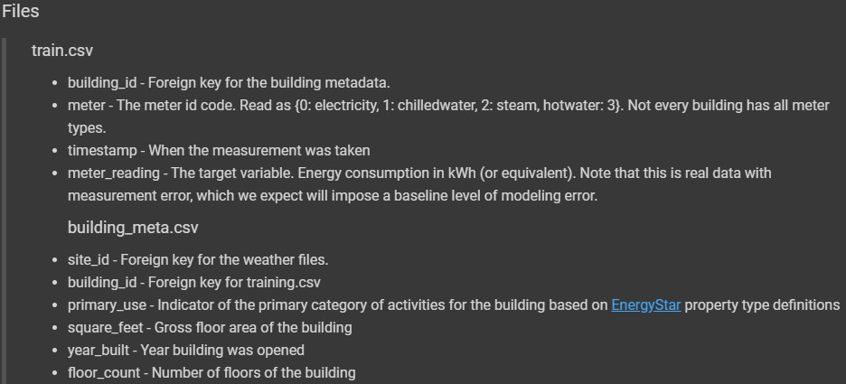
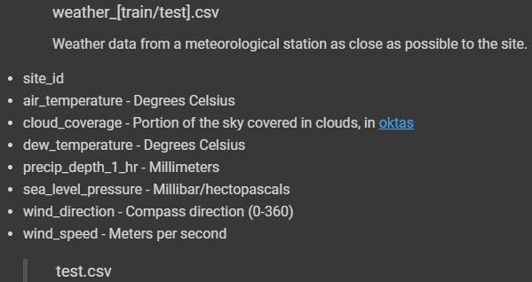
Datasets
Reading
1/4/2020
5

Slide 6
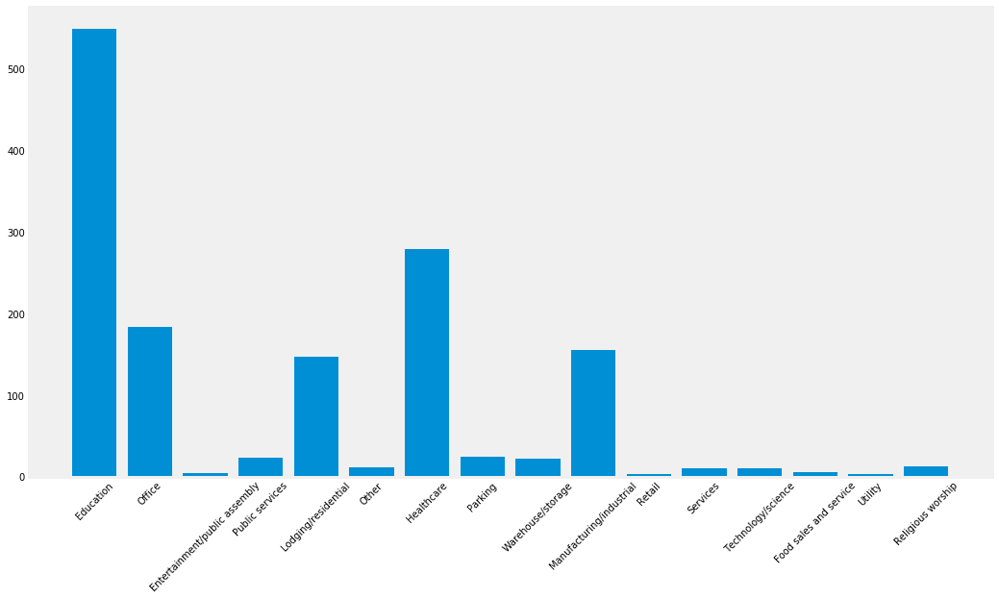
Visualisation
Data
building_meta_df['primary_use‘]
1/4/2020
6

Slide 7
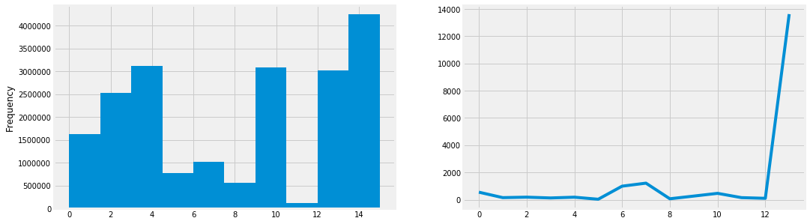
Data Visualisation
PowerPoint
Presentation
PowerPoint
Presentation
PowerPoint
Presentation
train_df[‘site_id']
1/5/2020
7

Slide 8
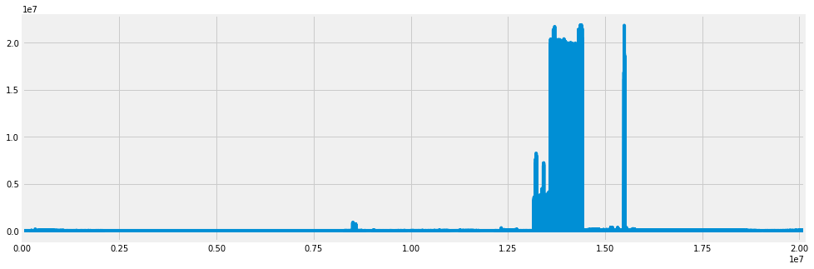
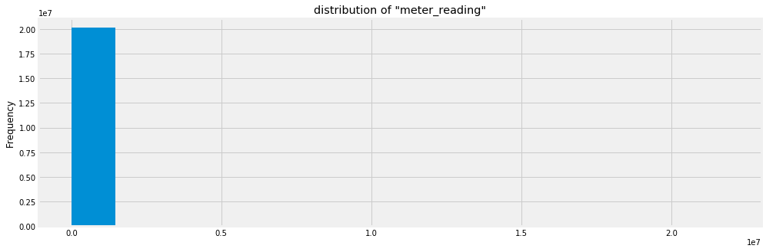
Data Visualisation
train_df['meter_reading']
1/4/2020
8

Slide 9
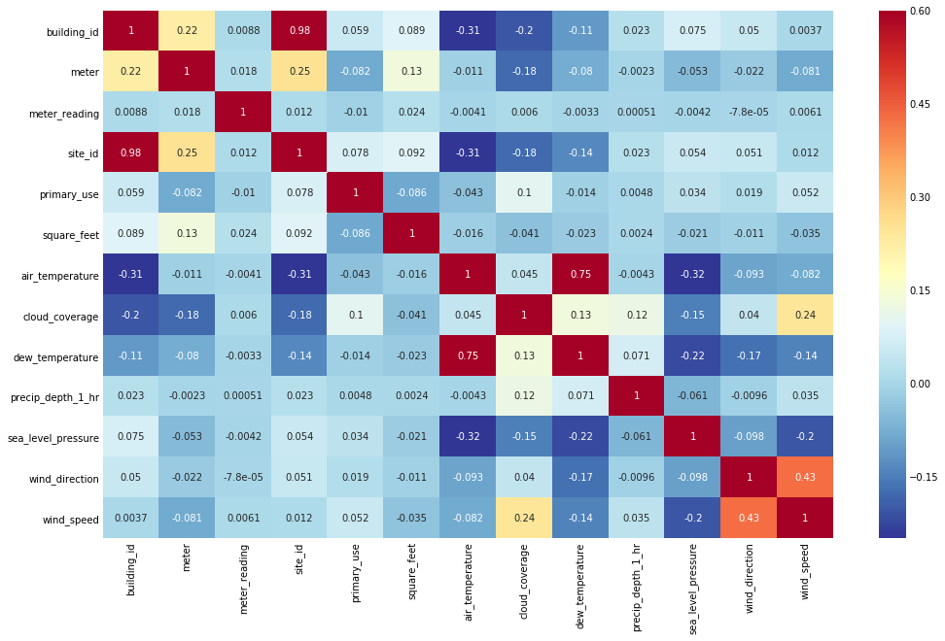
Correlation between train_df['meter_reading'] and other variables
1/5/2020
9

Slide 10
2) Data Preparation
1/4/2020
10

Slide 11
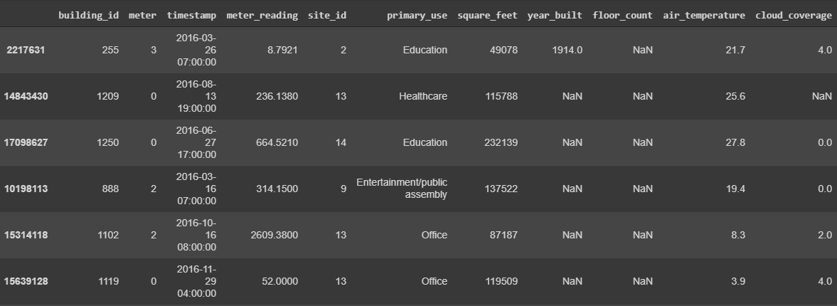
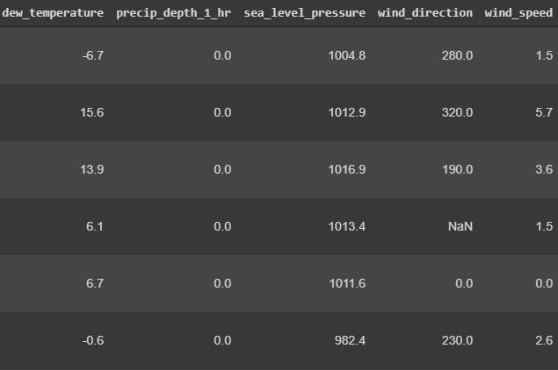
Data Merging
Sample rows from combined dataframe
1/4/2020
11

Slide 12
Data Preprocessing
01
02
Check how many 'NaN' values has each column
03
Change the 'primary_use' column to categorical
Check the description of train_df before Data Modeling
A lot of NaN's in some of columns
➔ Change them into numerical values or drop them (‘floor_count’ and ‘year_built’) in order to use this data in neural network
12

Slide 13
3) Data Modeling
1/4/2020
13

Slide 14
Data Shaping
In order to run LSTM neural network data has to be in three dimentional shape where axis corresponds to following data:
x-axis time steps
y-axis data examples
z-axis features for single point in time
1/4/2020
14

Slide 15
C
LEAN
ENERGY
Take data for first 10 building_id's and preprocess them for LSTM neural network
Dictionary 'extracted_df' contains data for buildings_ids in range (0, 10)
➔ Have to be reshaped in order to feed them into LSTM neural network
1/4/2020
15

Slide 16
Building Simple
LSTM Network
In order to create our LSTM model with tensorflow keras, we need to do these steps:
Splitting data according to provided parameters
Preparing data for three sets of data (train, dev, val) for every 'building_id'
Standardizing features by removing mean and scaling according to variances
Fitting to every data set with given 'building_id'
01
02
03
04
1/4/2020
16

Slide 17
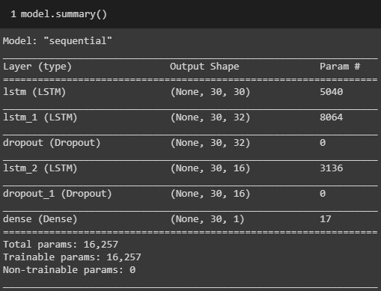
Model Summary
3 LSTM layers
2 Dropout layers ➔ Prevent the model overfitting
Necessity of a Dense layer in the end
1/5/2020
17

Slide 18
4) Results Analysing
1/5/2020
18

Slide 19
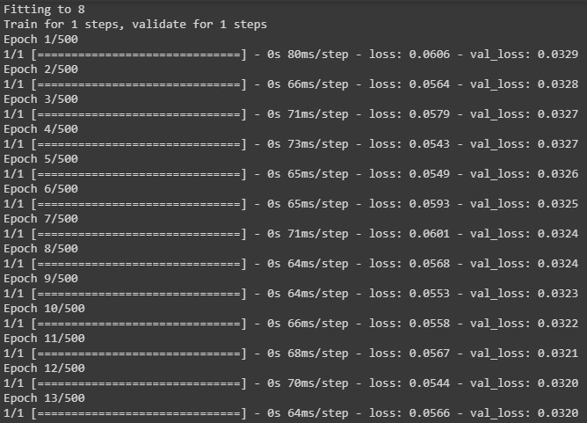
Choice of Hyperparameters
9 Model fitting epochs (because from the 10th epoch, the model starts to overfit)
Adam optimizer (because it can handle sparse gradients and noisy problems)
Mean Square Error loss (MSE)
500 epochs for each Fit
1/5/2020
19

Slide 20
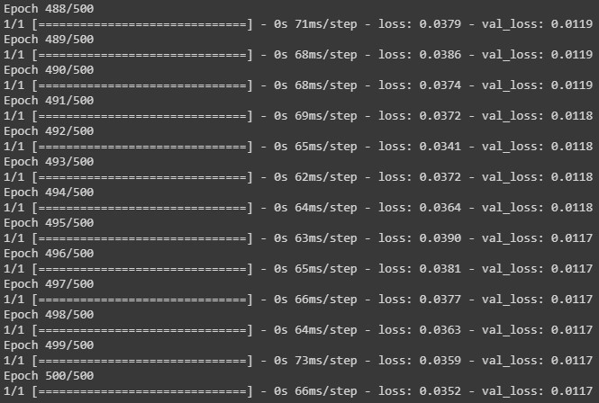
Final results
Final loss value: 0.0352
Final validation loss value: 0.0117
Validation loss < Training loss:
Reason may be: Training loss is measured during each epoch while validation loss is measured after each epoch. ➔ On average, the training loss is measured 1/2 an epoch earlier. If we shift the training loss curve a half epoch to the left, losses will align a bit better.
1/5/2020
20

Slide 21
Thank You

